Slide 1
The Impact of a Major Hurricane on Hampton Roads
Robert M. McNab
Dragas Center for Economic Analysis and Policy
Strome College of Business
Old Dominion University
June 3, 2019

Slide 2
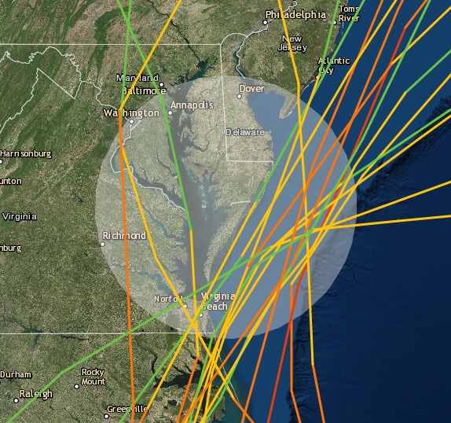
A Major Hurricane is Uncertain but Also Certain
Numerous storms have tracked over or west of Hampton Roads since 1850.
Climate change appears to affect hurricane formation and strength. Warmer seas are a harbinger of wetter storms.
Demographic and economic change has increased economic activity, population density, and building density in the urban crescent.
Hampton Roads is particularly challenged by topography and the number of viable evacuation routes.
Source: Washington Post (2018). Tropical storms and hurricane tracks through the Mid-Atlantic since 1851. Green indicates tropical storm strength, yellow category one hurricane, orange category two hurricane, and red category three hurricane. https://www.washingtonpost.com/news/capital-weather-gang/wp/2017/07/13/why-a-single-hurricane-has-not-directly-hit-virginia-maryland-or-delaware-since-1851/?utm_term=.633f6356447a. Also available at: https://coast.noaa.gov/digitalcoast/tools/hurricanes

Slide 3
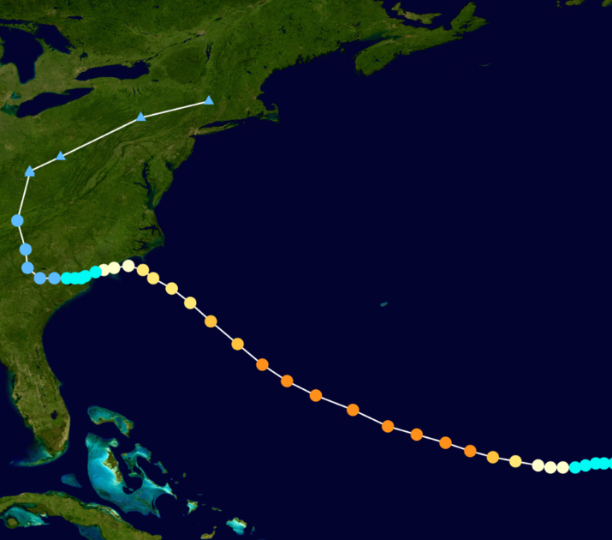
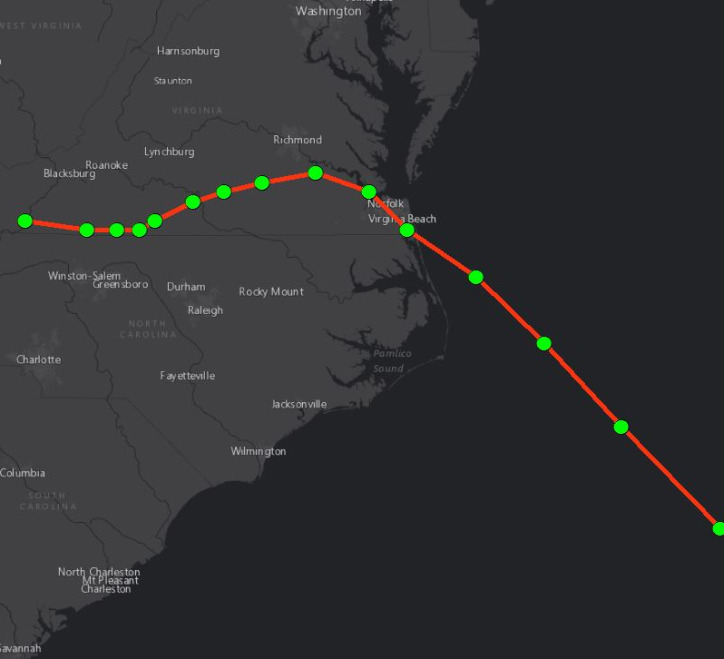
Hurricane Florence
Simulated Flooding Potential for Norfolk
Actual Track – landfall near Wilmington, N.C.
Modified track – landfall near VA – NC border
Hurricane Florence
Surge: 6’
Rain: 30+”
Speed: Slow
High Category 1 at landfall
Rapid Modeling Assumptions & Limitations: Storm surge is visualized using CAT 2 data (MOM approach). Localized rainfall of 36” is modeled for the entire study region (City of Norfolk) without spatial variation. Water losses or gains from stormwater utility system are not considered.

Slide 4
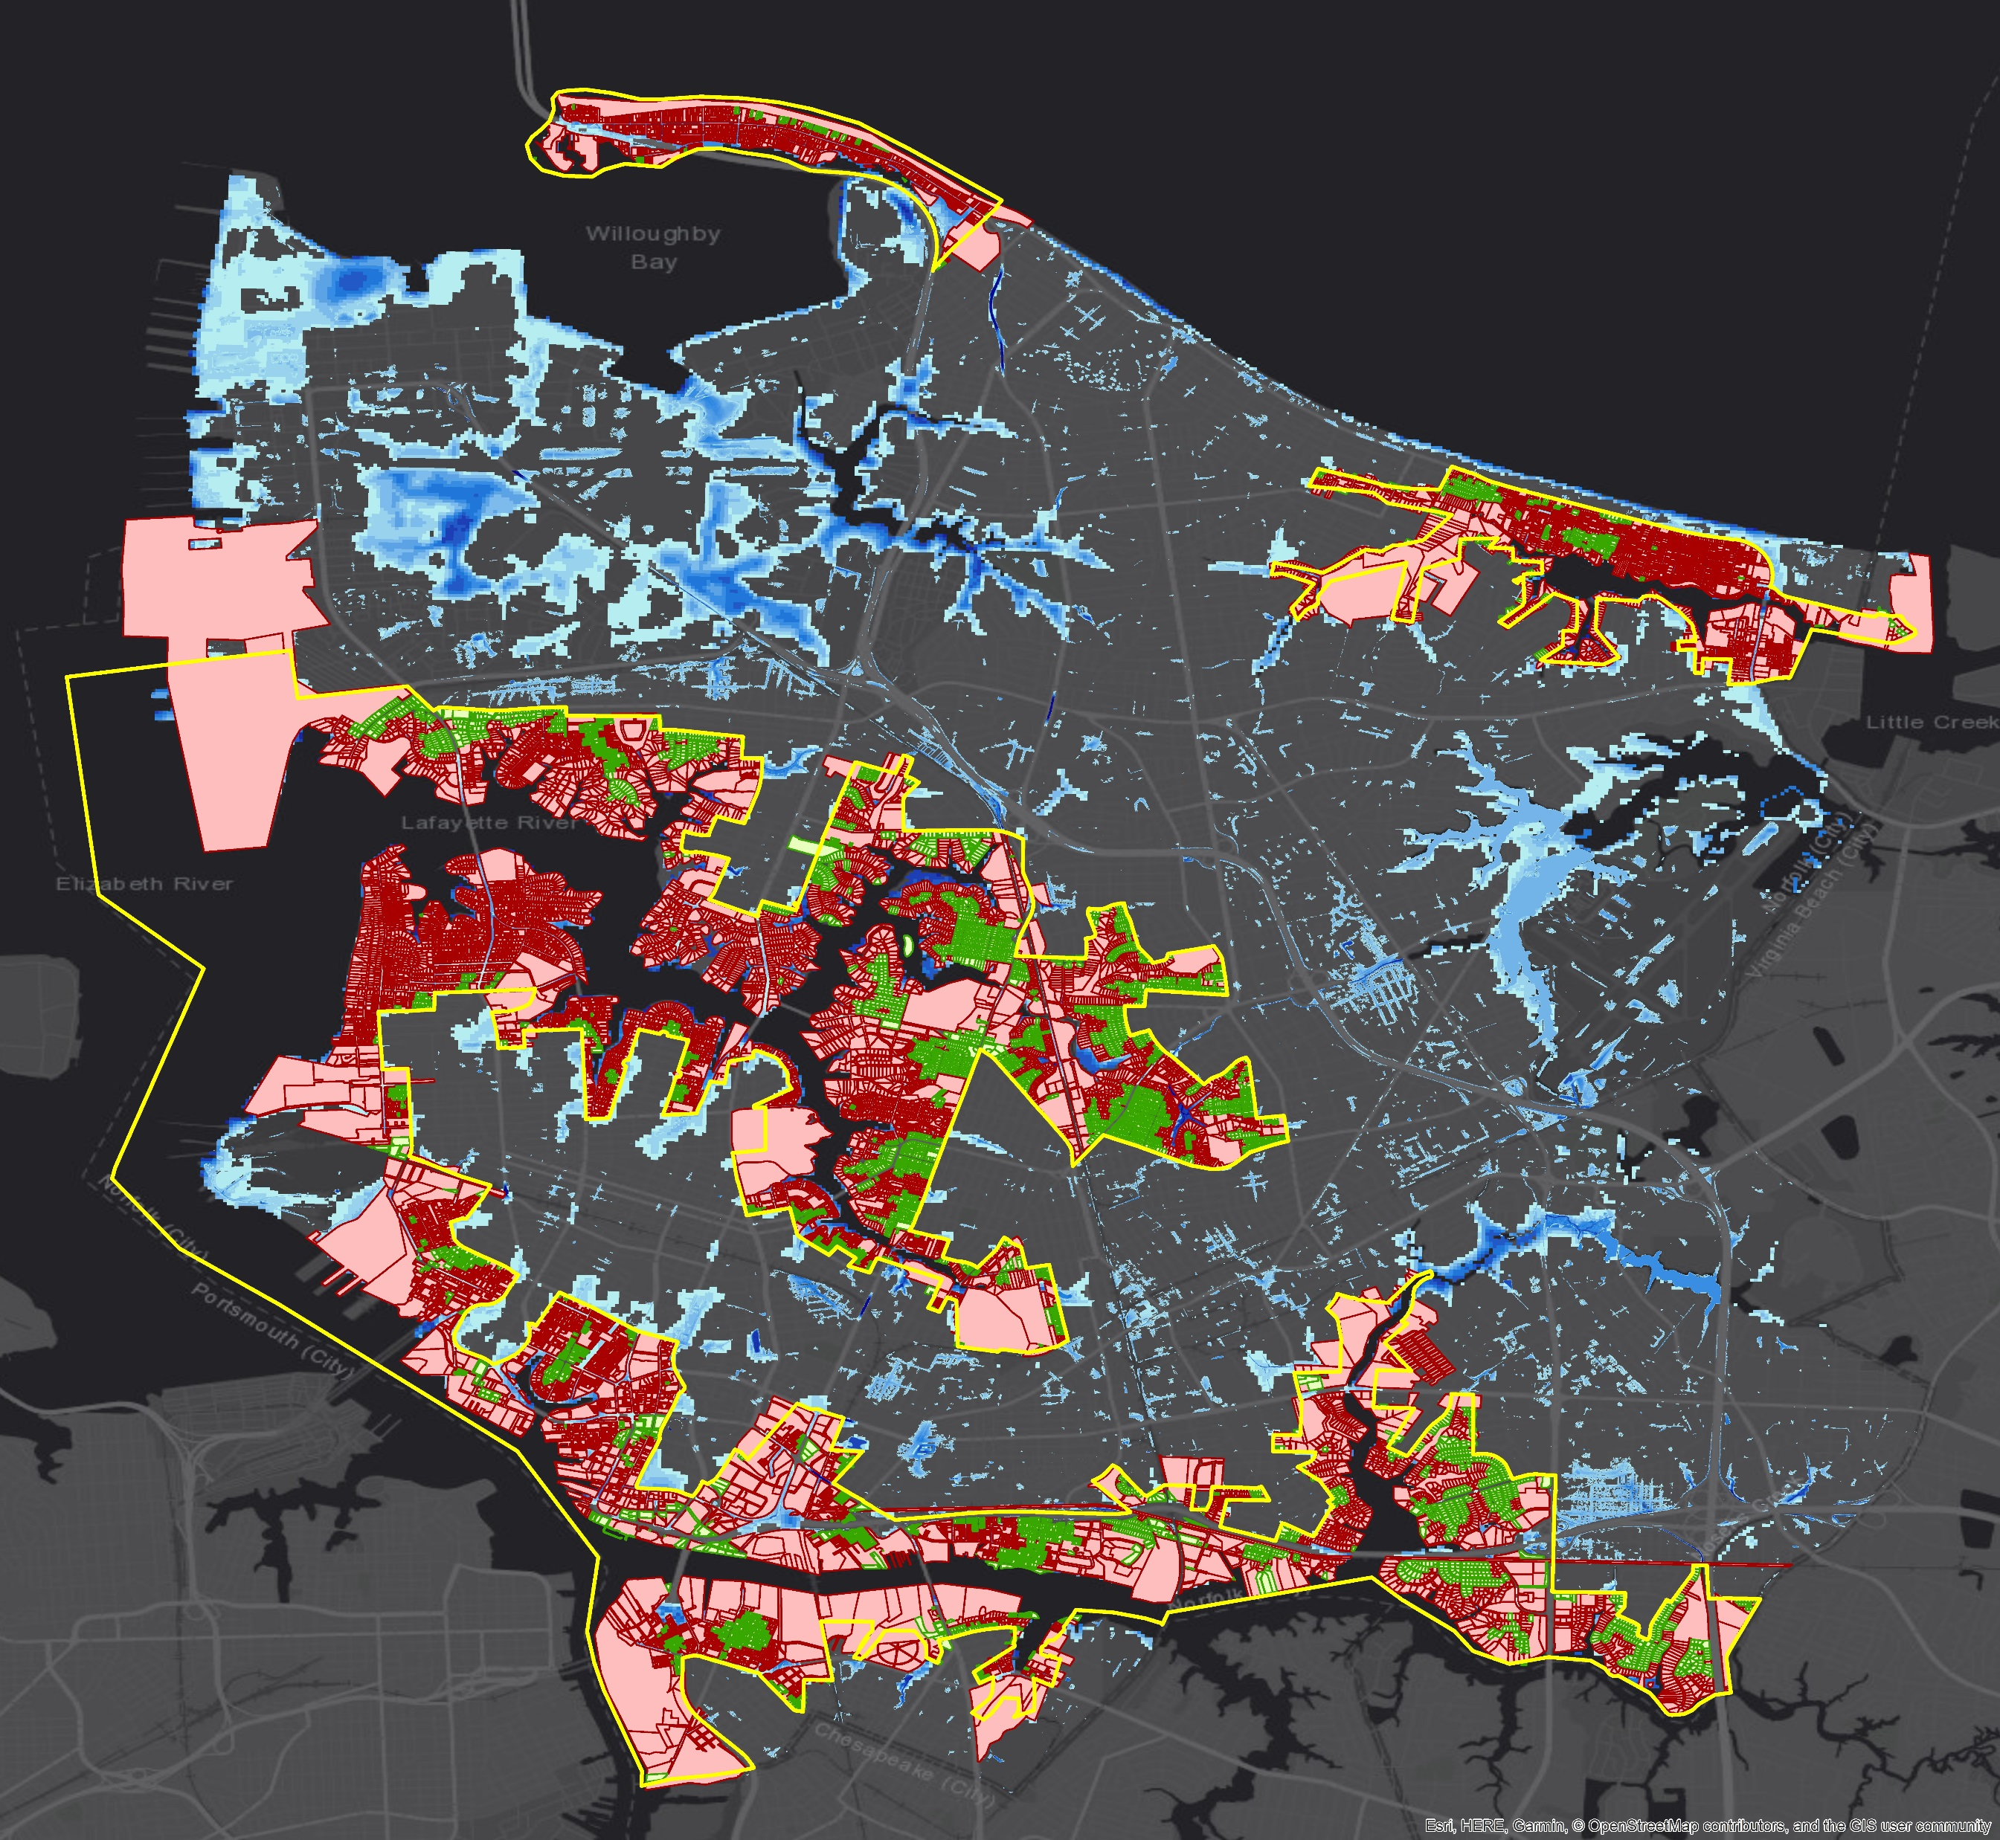
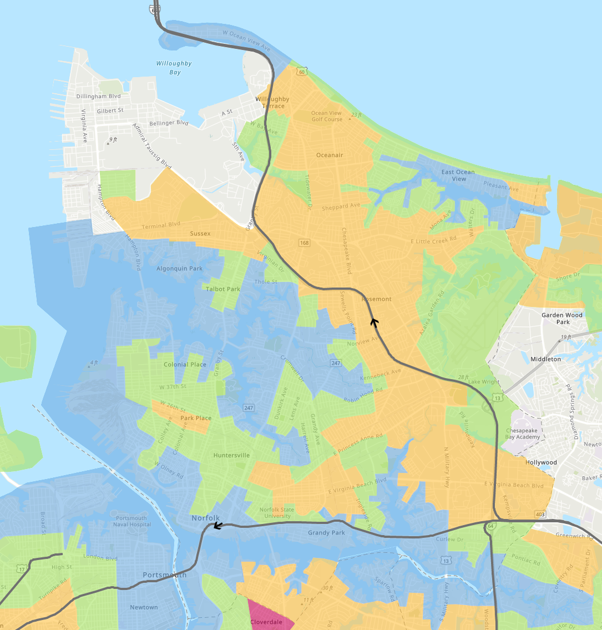
Evacuation Zones Compared to
Potential Flooding
ZONE A
Norfolk Total Parcels: 68,403
Parcels in Evac Zone A: 19,419
Parcels impacted
by flooding: 13,806 (71%)

Slide 5
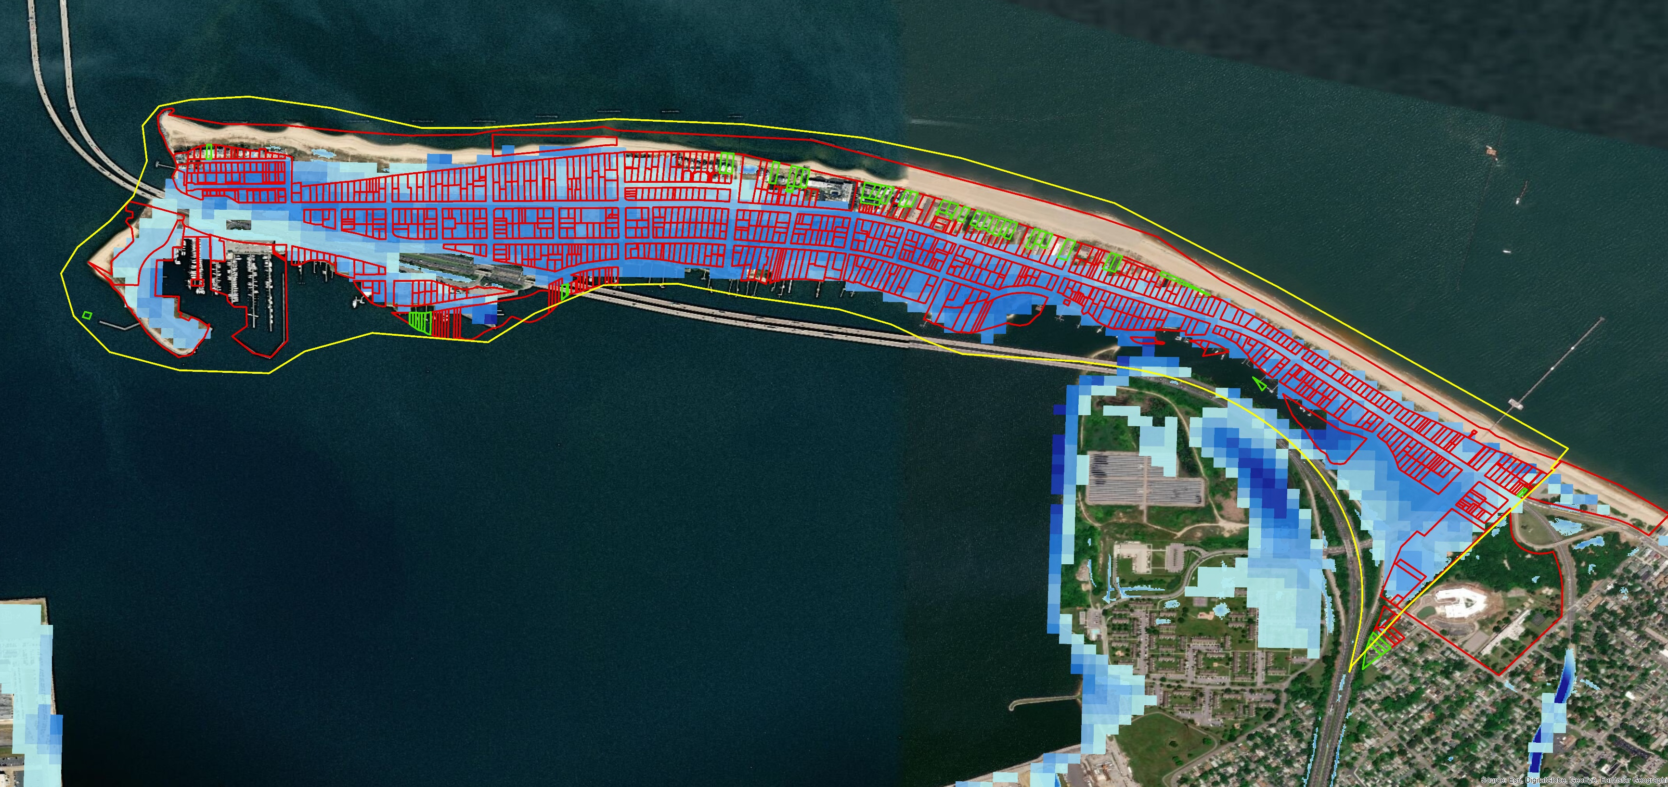
Willoughby – Ocean View

Slide 6
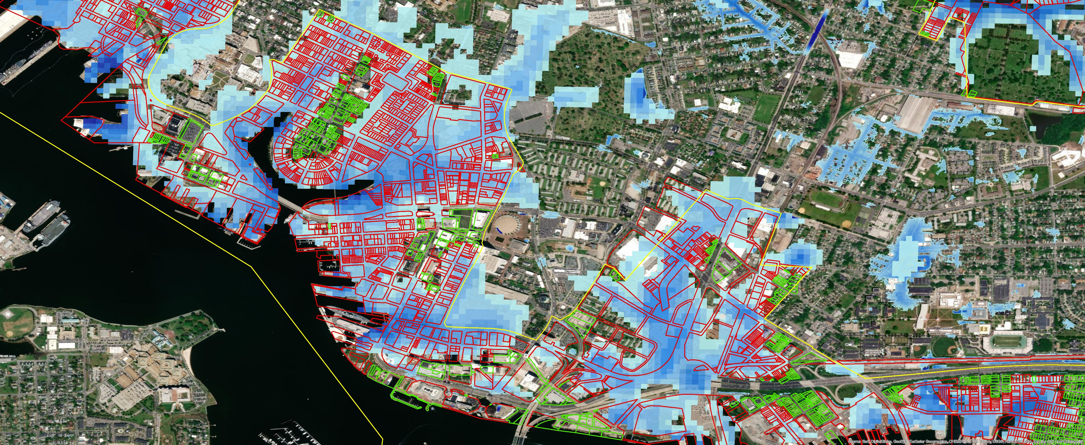
Downtown - Ghent

Slide 7
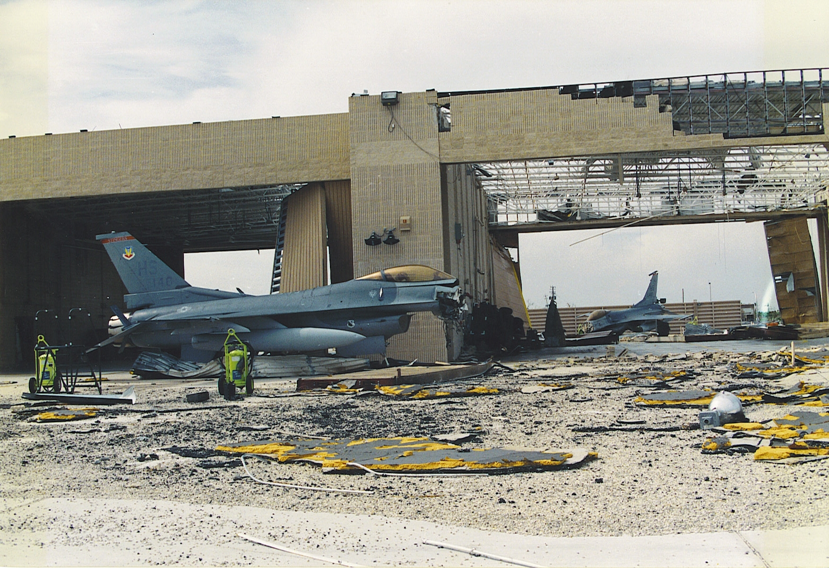
Estimating the Economic Impact of a Katrina-Class Event
Hurricane Katrina was a Category 3 hurricane at landfall with sustained winds of 100 to 140 miles per hour.
Jobs in the New Orleans metropolitan area declined by 17% in the first year after Katrina.
We proportionally apply these job declines by sector to the Hampton Roads economy to model the economic impact.
The post-Katrina declines in public employment translate into significant job declines in the public sector in Hampton Roads.
Source: United States Air Force (2012). Homestead Air Force Base after Hurricane Andrew.

Slide 8
Summary of Physical and Economic Impacts
Katrina-Class Hurricane Striking Hampton Roads
 | Buildings Affected (Destroyed) | Estimated Impact | Individuals Affected (Requiring Shelter)
Wind Damage | 20,137 (1,114) | >$4 billion | 1,500 (800)
Water Damage | 18,427 (6,231) | >$13 billion | 204,125 (15,000)
Employment Loss | -- | -- | >170,000
Output Loss | -- | >$22 billion | --
Total | >38,000 (>7,000) | >$40 billion | >380,000 (>15,000)
Source: Quarterly Census of Employment and Wages (2019), Chmura Economics – JobsEq, and Dragas Center for Economic Analysis and Policy. Percentages from the New Orleans Metropolitan Statistical Area are applied to 2017 employment and wages in the Hampton Roads MSA. HAZUS model estimates using a track similar to Hurricane Florence. Table represented estimated 1-year impact. Some double counting may occur as some individuals may have residences physically damaged and have employment loss.

Slide 9
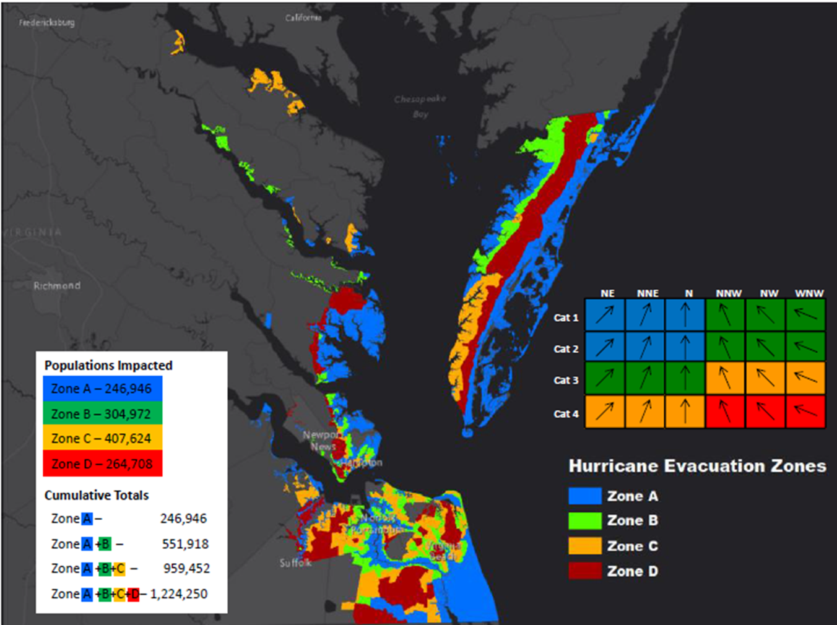
Evacuation is a Wicked Problem
The nature of the problem prevents a solution being known with certainty until the event has passed.
The correct decision made with uncertain information will appear to be the wrong decision when all the facts are in evidence.
The costs of evacuation and a storm shifting should be compared with the costs of not evacuating and the storm making landfall in the unevacuated area.
Even the “best” decision prior to landfall may have an adverse outcome because residents must take also take action.
Source: Washington Post (2018). Tropical storms and hurricane tracks through the Mid-Atlantic since 1851. Green indicates tropical storm strength, yellow category one hurricane, orange category two hurricane, and red category three hurricane. https://www.washingtonpost.com/news/capital-weather-gang/wp/2017/07/13/why-a-single-hurricane-has-not-directly-hit-virginia-maryland-or-delaware-since-1851/?utm_term=.633f6356447a. Also available at: https://coast.noaa.gov/digitalcoast/tools/hurricanes

Slide 10
Hurricane Florence: Household Evacuation Perception & Behaviors
Dr. Joshua Behr
Virginia Modeling, Analysis, and Simulation Center (VMASC)
Old Dominion University
June 3, 2019

Slide 11
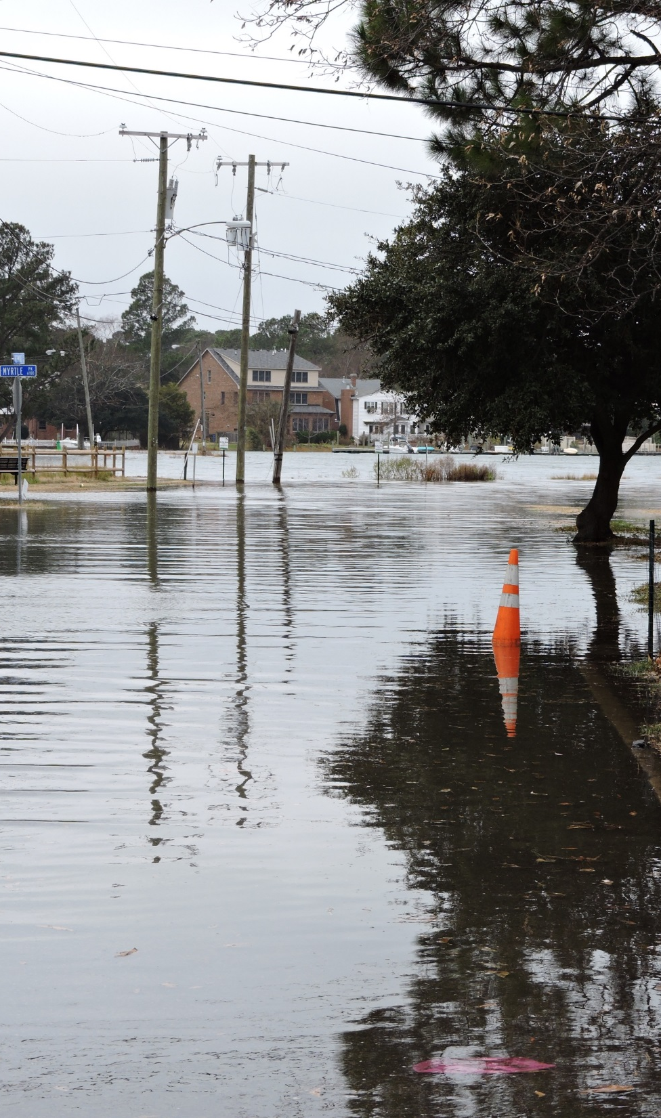
Household Evacuation Perception & Behaviors
Random, stratified sampling of over 1,200 households conducted by ODU’s Social Science Research Center in coordination with VMASC
Households within Chesapeake, Hampton, Newport News, Norfolk, Poquoson, Portsmouth, and Virginia Beach surveyed and geocoded
Able to compare analysis of evacuation behaviors during Hurricane Irene (no Zones or mandatory evacuation order) with those during Hurricane Florence
Preliminary data analysis presented here with report to follow

Slide 12
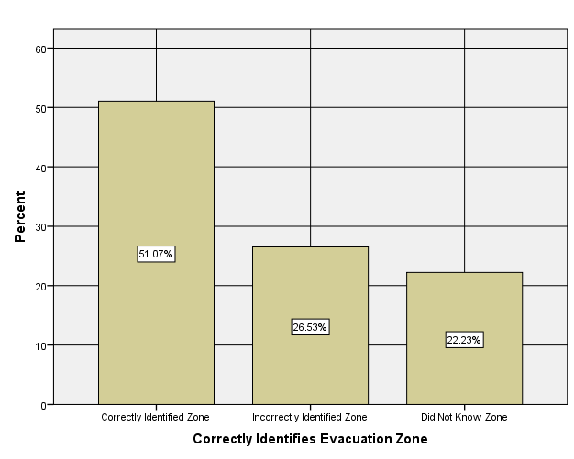
Correctly Identifies Evacuation Zone

Slide 13
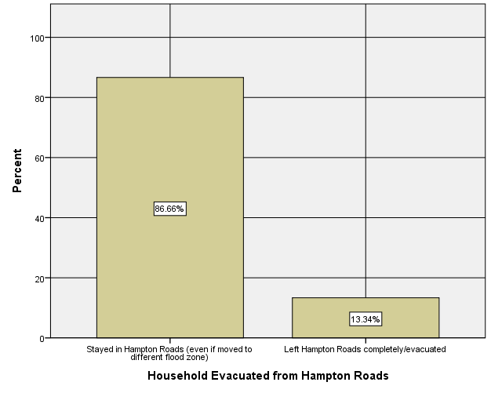
Household Evacuated from Hampton Roads

Slide 14
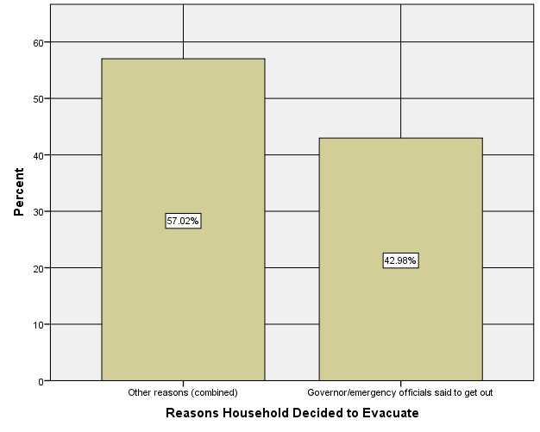
Reasons Household Decided to Evacuate

Slide 15
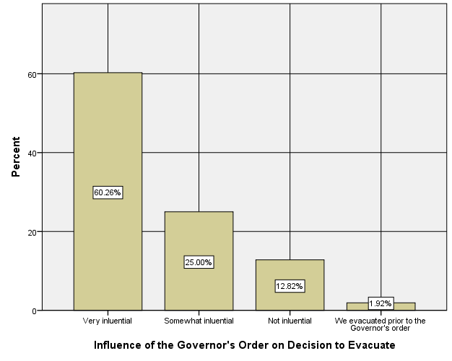
Influence of the Governor’s Order on Decision to Evacuate

Slide 16
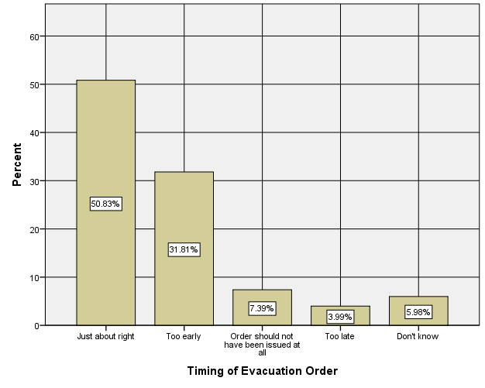
Timing of Evacuation Order

Slide 17
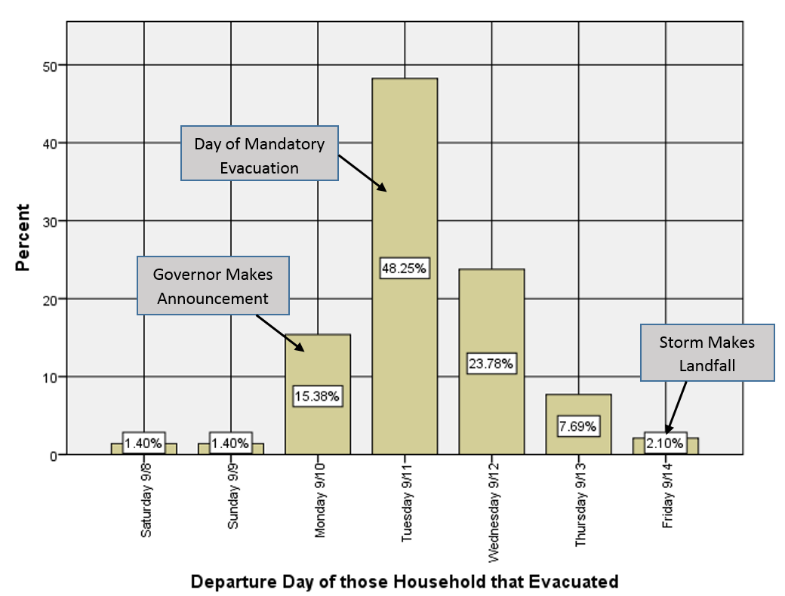
Departure Day of those Households that Evacuated

Slide 18
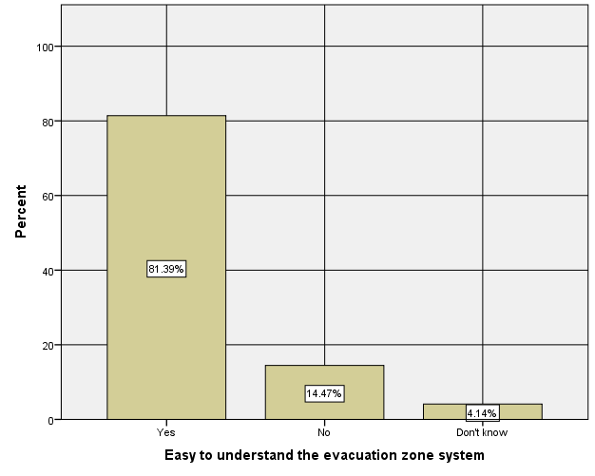
Easy to Understand the Evacuation Zone System

Slide 19
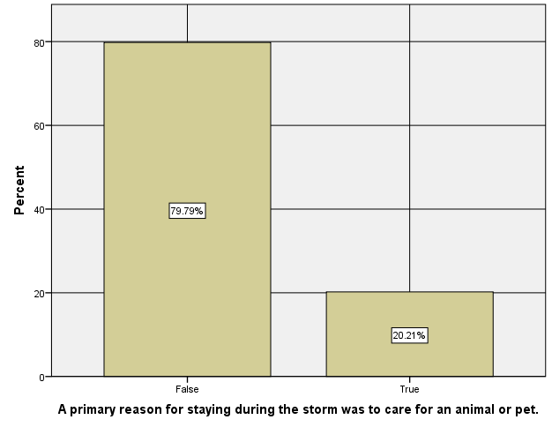
Primary Reason for Staying During Storm was Animal/Pet

Slide 20
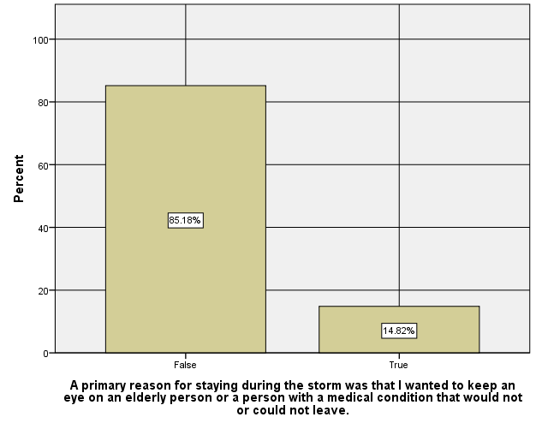
Primary Reason for Staying During Storm was Care for Elderly or Medically Fragile Person

Slide 21
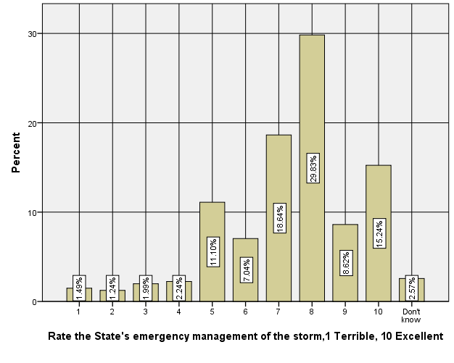
Rate the State’s Emergency Mgmt. of the Storm

Slide 22
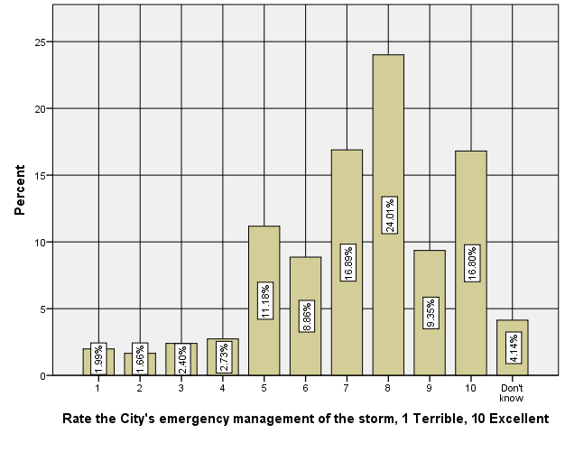
Rate the City’s Emergency Mgmt. of the Storm

Slide 23

Research supported by the Commonwealth Center for Recurrent Flooding Resiliency, www.floodingresiliency.org
Contact Emily Steinhilber, esteinhi@odu.edu for more information.
CONTACT:
Robert M. McNab, rmcnab@odu.edu
Joshua Behr, jbehr@odu.edu
Report & Slides Available:
www.floodingresiliency.org/florence

